Slide 1
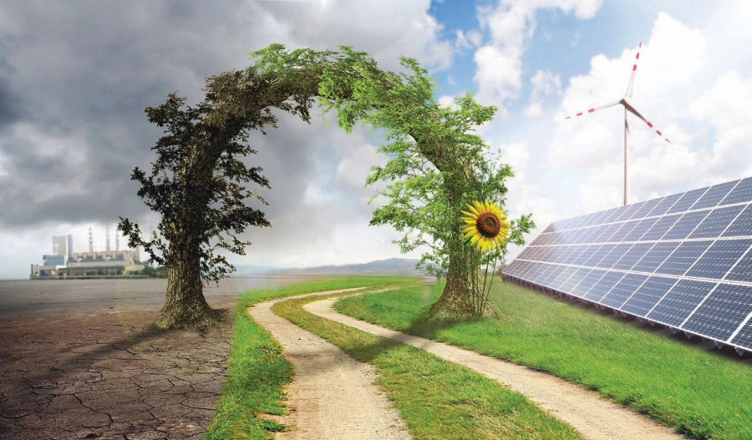
RENEWABLE ENERGY SERIES
Alternate Energy
Sources
Hydro, Biomass & Biogas,
and Ocean Thermal Energy
Sustainable Solutions for a Greener Future

Slide 2
Navigation
Contents
01
The Need for Alternate Energy
04
Ocean Thermal Energy
Understanding the global context of energy transition and environmental challenges
Tapping into the ocean's temperature gradient for power generation
02
Hydroelectric Energy
Harnessing the power of flowing water for clean electricity generation
05
The Path Forward
Investing in sustainable technologies for a cleaner, greener, and more energy-secure future
03
Biomass and Biogas
Transforming organic waste into valuable renewable energy resources
Key insights and recommendations for energy transition

Slide 3
Introduction
The Need for Alternate Energy Sources
Environmental Impact
Why Renewables Matter
Fossil fuel combustion releases massive amounts of CO₂ and pollutants, driving climate change and degrading air quality worldwide. The transition to renewables is essential for environmental protection.
Sustainable
Infinite energy supply
Eco-Friendly
Resource Depletion
Minimal environmental impact
Coal, oil, and natural gas reserves are finite and depleting rapidly. Global energy demand continues to rise, making the shift to renewable sources critical for long-term energy security.
Cost-Effective
Declining technology costs
Energy Security
Global Commitment
Renewable energy sources are domestically available and inexhaustible, reducing dependence on imported fuels and enhancing national energy independence and economic stability.
The Paris Agreement and national policies worldwide are driving unprecedented investment in renewable energy technologies, creating momentum for a sustainable energy future.

Slide 4
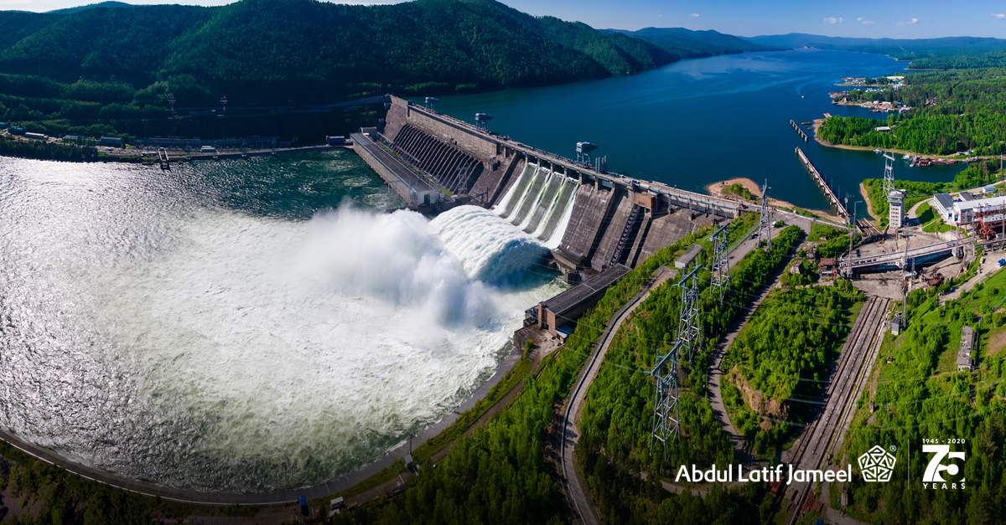
CHAPTER 01
Hydroelectric
Energy
Harnessing the Power of Flowing Water

Slide 5
Hydroelectric Energy
How Hydroelectric Power Works
1
Water Collection
Types of Hydroelectric Installations
Water is collected in reservoirs behind dams or diverted from rivers. The stored water represents potential energy that can be converted to electricity on demand.
Storage Dams
Gravity creates pressure
Large reservoirs store water for consistent power generation and grid stability
Run-of-River
2
Turbine Rotation
Uses natural river flow with minimal environmental disruption
Water flows through penstocks and strikes turbine blades, causing them to spin. Modern turbines can achieve 90%+ efficiency in converting water power to mechanical energy.
Pumped Storage
Kinetic energy conversion
Acts as giant batteries, storing energy by pumping water uphill during low demand
3
Electricity Generation
The spinning turbine drives a generator, converting mechanical energy into electrical energy through electromagnetic induction. Power is then transmitted to the grid.
Historical Significance
Clean electricity output
Hydropower is one of humanity's oldest energy sources, with water wheels dating back thousands of years. Today it provides 16% of global electricity.

Slide 6
Hydroelectric Energy
Benefits and Applications of Hydropower
Reliable Baseload
Clean Energy
Global Hydropower Statistics
Unlike solar and wind, hydropower provides consistent electricity 24/7, making it ideal for baseload power supply and grid stability.
Produces minimal greenhouse gas emissions during operation—far less than fossil fuels. Lifecycle emissions are among the lowest of all energy sources.
Global Capacity
1,360 GW
Electricity Share
16%
Renewable Share
54%
Rapid Response
Long Lifespan
Countries Using
150+
Can go from zero to full power in minutes, providing essential grid balancing services and supporting integration of variable renewables.
Hydroelectric facilities can operate for 50-100+ years with proper maintenance, providing decades of low-cost clean energy.
Leading Countries
China
370 GW
Multi-Purpose Benefits
Brazil
109 GW
Beyond electricity, dams provide flood control, irrigation water, drinking water supply, and recreational opportunities—delivering comprehensive value to communities.
Canada
81 GW
United States
80 GW

Slide 7
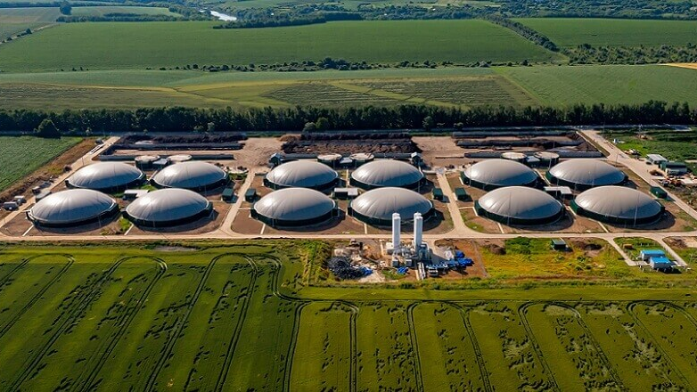
CHAPTER 02
Biomass and
Biogas
Transforming Organic Waste into Clean Energy

Slide 8
Biomass and Biogas
Biomass Energy: Sources and Process
Biomass Feedstock Types
Environmental Benefits
Agricultural Residues
Wood & Forestry
Waste Reduction
Crop stalks, straw, husks, and bagasse from farming operations
Wood chips, sawdust, bark, and dedicated energy crops
Diverts organic waste from landfills, reducing methane emissions
Carbon Neutral
CO₂ released equals what plants absorbed during growth
Animal Waste
Municipal Waste
Rural Development
Manure from livestock operations, rich in organic matter
Organic fraction of household and industrial waste streams
Creates local jobs and income from agricultural waste
Energy Security
Locally available resource reduces import dependence
Conversion Technologies
1
Direct Combustion
Burning biomass to produce heat for electricity generation or industrial processes—simplest and most widely used method.
2
Gasification
Heating biomass with limited oxygen to produce syngas (hydrogen and carbon monoxide) for cleaner burning.
3
Pyrolysis
Key Insight
Thermal decomposition in absence of oxygen to produce bio-oil, biochar, and syngas for various applications.
Biomass is the world's fourth-largest energy source, providing approximately 10% of global primary energy supply, with significant growth potential in developing regions.

Slide 9
Biomass and Biogas
Biogas Production and Rural Applications
Anaerobic Digestion Process
Biogas Composition
1
Feedstock Input
Methane (CH₄)
60-70%
Organic materials like animal manure, crop residues, and food waste are collected and pre-treated.
Primary energy component
2
Digestion Tank
Carbon Dioxide (CO₂)
30-40%
Materials are placed in oxygen-free digesters where bacteria break down organic matter over 20-40 days.
Inert gas component
Other Gases
<1%
3
Biogas Collection
Methane-rich gas (60-70% CH₄) is captured and stored for use in cooking, heating, or electricity generation.
H₂S, NH₃, trace elements
4
Digestate Output
Rural Applications
Nutrient-rich residue serves as organic fertilizer, completing the circular economy loop.
Cooking
Heating
Lighting
Power
Transforming Rural Lives: Biogas systems provide clean cooking fuel, reduce indoor air pollution, improve sanitation through waste management, and generate organic fertilizer—creating multiple benefits for farming communities.

Slide 10
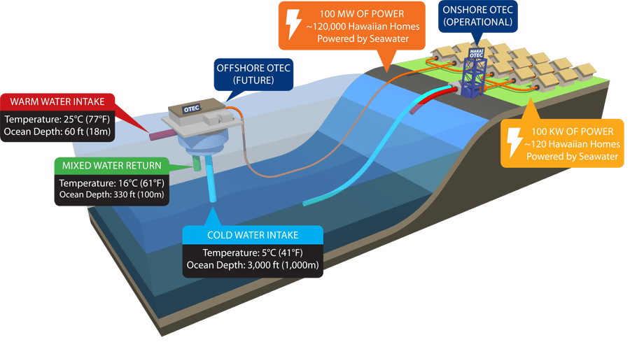
CHAPTER 03
Ocean Thermal
Energy
Tapping into the Ocean's Temperature Gradient

Slide 11
Ocean Thermal Energy
Ocean Thermal Energy Conversion (OTEC)
The Temperature Differential Principle
Advantages & Potential
OTEC exploits the natural temperature difference between warm surface seawater (25-30°C) and cold deep ocean water (4-7°C) to generate electricity through a heat engine cycle.
Continuous Power
Unlike solar/wind, OTEC provides baseload power 24/7, 365 days a year
Freshwater Production
Open-cycle systems can produce significant amounts of desalinated water
Surface Water
Deep Water
25-30°C
4-7°C
Mariculture Benefits
Cold nutrient-rich deep water supports aquaculture and agriculture
Tropical Potential
OTEC System Types
Ideal for tropical coastal regions where temperature differentials are greatest
Closed-Cycle OTEC
Uses ammonia or other working fluid with low boiling point. Warm water vaporizes fluid → drives turbine → cold water condenses vapor. Most efficient design.
Open-Cycle OTEC
Current Development Status
Warm seawater flash-evaporates in vacuum chamber → steam drives turbine → cold seawater condenses steam. Produces desalinated water as byproduct.
First Operational Plant
Hawaii, 2015
Hybrid Systems
Current Capacity
~100 kW - 1 MW
Combines benefits of both approaches for enhanced efficiency and additional freshwater production.
Future Potential
100+ MW plants
Target Regions
Tropical coasts

Slide 12
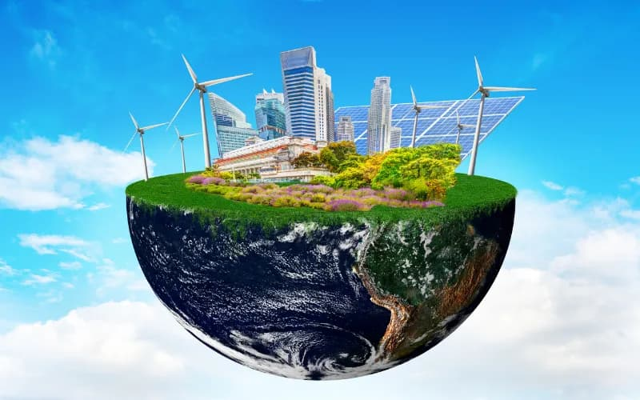
CONCLUSION
The Path Forward:
Investing in a Sustainable Future
Environmental Protection
Energy Security
Sustainable Development
Alternate energy sources significantly reduce greenhouse gas emissions, air pollution, and environmental degradation compared to fossil fuels.
Renewable resources are domestically available and inexhaustible, reducing dependence on imported fuels and price volatility.
Clean energy creates jobs, stimulates rural economies, and provides affordable power to communities worldwide.
Call to Action
Continued investment in hydroelectric, biomass, biogas, and ocean thermal technologies is essential for achieving climate goals and ensuring a cleaner, greener, and more energy-secure future for generations to come. The transition to renewable energy is not just an option—it is an imperative.

